Slide 1
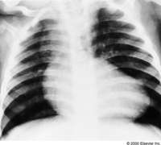
INTRODUCTION TO CONGENITAL HEART DISEASES AND ACYANOTIC CONGENITAL HEART DISEASES
EU Department of Paediatrics

Slide 2
OUTLINE
Fetal circulation
Circulatory changes at birth
Definition of CHD
Epidemiology
Classification
Etiology of CHDs
Acyanotic CHDs: VSD, ASD, PDA, COA
Cyanotic CHDs: TOF, TGAs, T.Atresia, T.Arteriosus, TAPVR, AVSD

Slide 3
FETAL CIRCULATION
Umbilical cord has;
  1 umbilical veins- supplies nutrient and oxygen to the fetus
  2 umbilical arteries- drains the fetal waste, CO2 and deox2 blood
3 shunts
  Ductus venosus- connects umbilical vein to inferior vena cava by bypassing the liver
  Foramen ovale- allows blood to flow from right atria to the left atria by bypassing the lungs.
  Ductus arteriosus- connects the pulmonary artery to aorta

Slide 4
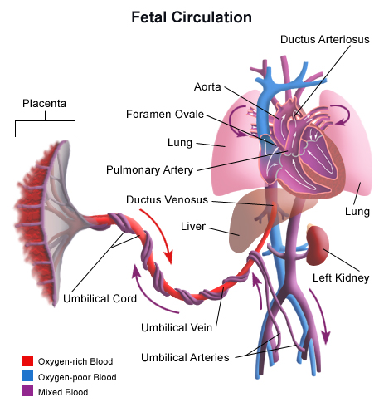
.

Slide 5
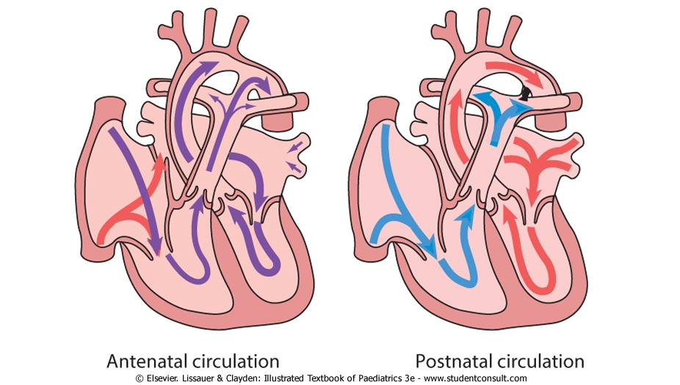
CIRCULATORY CHANGES AT BIRTH

Slide 6
CONGENITAL HEART DISEASE
Definition:
  Failure of normal cardiac development or persistence of the fetal circulation after birth.
  Heart abnormality present at birth

Slide 7
EPIDEMIOLOGY
CHD occurs in 8 per 1000 infants .
About 1 in 10 stillborn infants have a cardiac anomaly.
About 10-15% have complex lesions with more than 1 cardiac abnormality.
About 10-15 % also have non-cardiac abnormality.
CHD is the most common group of structural malformations in children.

Slide 8
CHD classification
There are three categories:
1. Obstructive Congenital Heart Lesions
2. Congenital Heart Lesions that increase Pulmonary Arterial Blood Flow (L→R shunts)
3. Congenital Heart Lesions that decease Pulmonary Arterial Blood Flow (Cyanotic CHD i.e R→L shunts)

Slide 9
CLASSIFICATION
CHD
Acyanotic
Cyanotic
Tetralogy of Fallot(5%)
Transposition of the great arteries (5%)
Atrioventricular septal defect (AVSD) (2%)
Tricuspid atresia
Total anomalous pulmonary venous return
Pulmonary stenosis (7%)
Hypoplastic left ventricle
Truncus arteriousus
Left-to-right shunts
Outflow obstruction
- Ventricular Septal Defect (VSD)(30%)
- Persistent Ductus Arteriosus (PDA)(12%)
- Atrial Septal Defect (ASD) (7%)
- Aortic Stenosis (5%)
-Coarctation of aorta (5%)

Slide 10
ETIOLOGY
Most cases are multifactorial.
Maternal disorders
Rubella infection (30-35%)
Maternal drugs
Warfarin therapy (5%)
Fetal alcohol syndrome (25%)
Chromosomal abnormality
Down’s syndrome (30%)
SLE (35%)
DM (2%)
Complete heart block
PDA, peripheral pulmonary stenosis
PDA, pulmonary valve stenosis
ASD, VSD, tetralogy of Fallot
Atrioventricular septal defect, VSD
Edward’s and Patau’s syndrome (60-80%)
Complex disorders
Turner’s syndrome (15%)
Aortic valve stenosis, coarctation of the aorta
Pre-pregnancy folate def.
Maternal obesity.

Slide 11
Signs and symptoms
•S & S are related to the type and severity of the heart defect.
•Some children have no signs while others may exhibit:
-shortness of breath, cyanosis, chest pain, syncope, sweating, heart murmur, respiratory infections, wasting, poor feeding, or poor growth, oedema in the feet, ankles, legs and lungs and Some may cause heart murmurs.

Slide 12
ACYANOTIC HEART DISEASES
VSD
ASD
PDA
Obstructive lesions : COA (Coarctation of the
aorta), Aortic stenosis

Slide 13
Diagnosis of CHDs
TBC: Hb, WBC, platelet count
Urea, Electrolytes
BGAs/O2 sats
CXR
ECG
Echocardiogram
coagulation profile
Cardiac Catheterization

Slide 14
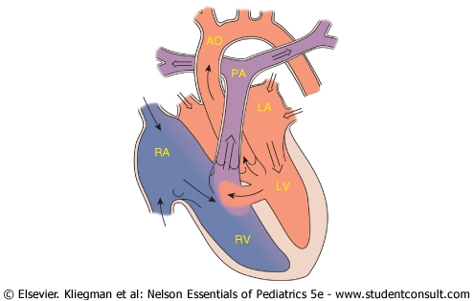
LEFT-TO-RIGHT SHUNTS

Slide 15
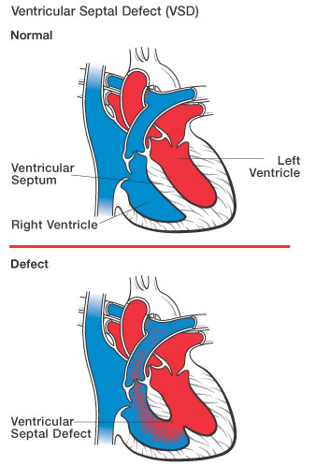
VENTRICULAR SEPTAL DEFECT (VSD)

Slide 16
VSD
Defect in the ventricular septum- the wall separating the right and left ventricles.
The ventricular septum consists of an inferior muscular and superior membranous portion.
Most common type of congenital heart disease accounting for 30% of all cases
Can occur singly or in multiples anywhere along the ventricular septum
Small defects often close spontaneously in the first 2 years of life while large defects require surgical repair within the 1st year

Slide 17
Cont…
•Notable;
Peri-membranous VSDs are more common than muscular VSDs.
Race: no particular racial predilection
Cause: The cause of VSD is the incomplete looping of the heart during days 24-28 of development.

Slide 18
VSD
Prevalence is equal between boys and girls
Due to increased pressures in the left ventricle, left to right shunting of oxygenated blood occurs
With the increased pulmonary blood flow, pulmonary hypertension can occur with large defects

Slide 19
Pathophysiology
During ventricular systole, some of the blood from the left ventricle shunts into the right ventricle, passes through the lungs and reenters the left ventricle via the pulmonary veins and left atrium.
This has two significant effects:

Slide 20
Cont…
1.Volume overload on the left ventricle.
2.Elevation of right ventricular pressure and volume, resulting in pulmonary hypertension. (This is because the left ventricle normally has a much higher systolic pressure (~120 mm Hg) than the right ventricle (~20 mm Hg), therefore the left to right shunt)

Slide 21
Anatomical classification of VSDs
Type I: para/ perimembranous - most common
Type II: Muscular (inlet, swiss-cheese) – least common
Type III: Outlet (supracristal,subpulmonary,infundibular or conoseptal)
Type IV: Atrioventricular : Avcanal defect

Slide 22
SYMPTOMS OF VSD
Usually asymptomatic at birth, manifesting few weeks after birth.
Rapid breathing
Irritability
Excessive Sweating
Poor weight gain
Congestive Heart Failure, usually within 6 to 8 weeks of life if defect is large
Pulmonary Hypertension if defect is large

Slide 23
Examination findings;
Heart sounds are normal.
Pansystolic murmur (depending upon the size of the defect) maximal at the left sternal border. [A Small VSD gives a louder murmur that a large VSD]
+/- palpable thrill (palpable turbulence of blood flow).
Larger VSDs may cause a parasternal heave and a displaced apex as the heart enlarges.

Slide 24
Diagnosis
A VSD can be detected by cardiac auscultation- Classically, a VSD causes a pathognomonic holo- or pansystolic murmur. Auscultation is generally considered sufficient for detecting a significant VSD. However there are situations that give rise to a silent VSD on auscultation such as:
in the fetus (when the right and left ventricular pressures are equal)

Slide 25
Continuation…
2. for a short time after birth (before the right ventricular pressure has decreased)
3. as a late complication of unrepaired VSD due to reversal of the shunt
Echocardiography to confirm auscultatory findings.
Cardiac catheterization to measure ventricular pressures.
CXR shows:

Slide 26
Cont…
-an enlarged heart: biventricular hypertrophy
-Increased vascularity in the lung fields
-Or can be normal in small VSDs
Others: CT scan/MRI

Slide 27
TREATMENTS FOR VSD- either conservative or surgical
Smaller VSDs often close spontaneously as the heart grows by the age of 7-8 years, and in such cases treatment is mostly conservative. Drugs used include;
-cardiac glycosides – digoxin
-diuretics – furosemide, aldactone
-ACE inhibitors -captopril
If surgery needed, patching or suturing the defect can be done. Mortality from surgery is low.

Slide 28
Indications of surgical intervention;
- Failure of CCF to respond to medications
-VSD with pulmonary stenosis
-Large VSD with pulmonary hypertension
-VSD with aortic regurgitation
Contraindication;
-severe pulmonary vascular disease.

Slide 29
complications
Congestive cardiac failure
Infective endocarditis on rt.ventricular side
Aortic insufficiency
Complete heart block
Delayed growth & development (FTT) in infancy
Damage to electrical conduction system during surgery(causing arrythmias)
Pulmonary hypertension

Slide 30
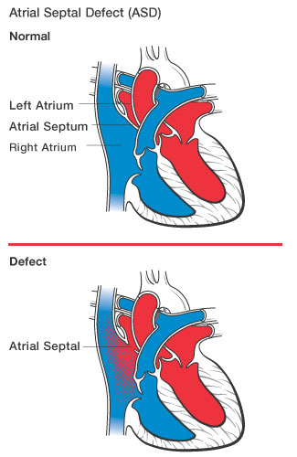
ATRIAL SEPTAL DEFECT (ASD)

Slide 31
ASD
Due to increased pressures on the left side of the heart, there is left to right shunting of oxygenated blood
If large defect, can cause enlarged right atria, right ventricle, and pulmonary artery resulting in abnormal arrhythmias
CHF can occur if left untreated.
F>Ms

Slide 32
Pathophysiology;
Cardiac tissues are 1st detectable on the 18th or 19th day of fetal life. Cardiac development continues for the next several weeks. Atrial septum begins to form during the 4th wk of gestation and is complete by the end of 5 weeks' gestation.
During development of the fetus, the inter-atrial septum develops to separate the left and right atrium.
However, the foramen ovale allows blood from the right atrium to the left atrium during fetal development.

Slide 33
Cont…
After birth, the pressure in the pulmonary circulatory system drops, thus causing the foramen ovale to close entirely, when the septum secundum apposes onto the septum primum.
In approximately 25% of adults the foramen ovale does not entirely seal- Patent foramen ovale (PFO)
This occurs in case there is elevation of pressures in the pulmonary circulatory system (i.e. pulmonary htn due to various causes). Its considered a remnant of the fetal f.ovale & has little hemodynamic consequences.

Slide 34
Types of ASD
They are differentiated from each other by 2 factors:
-if they involve other structures of the heart
-how they are formed during the developmental process during early fetal development.
Ostium primum
Ostium secundum
Sinus venosus
Coronary sinus
Mixed

Slide 35
conti
Ostium secundum ASD; is the most common type and comprises 6-10% of all CHD. The secundum ASD usually arises from: -an enlarged foramen ovale , inadequate growth of the septum secundum, or excessive absorption of the septum primum
Ostium primum ASD: This results from failure of the endocardial cushions to close the ostium primum. They are classified as AV defects since the endocardial cushions form part of the tricuspid and bicuspid valves.

Slide 36
Cont.
A sinus venosus ASD; is a type of in which the defect in the septum involves the venous inflow of either the superior vena cava or the inferior vena cava.
Coronary sinus septal defect ; A portion of the roof of the coronary sinus is missing, therefore blood can be shunted from the left atrium into the coronary sinus and subsequently into the right atrium.
Mixed Atrial septal defect; The inter atrial septum can be divided in to 5 septal zones. If the defect involves 2 or more of the 5 septal zones, is termed a MASD.

Slide 37
Clinical fxs
Most infants and children are asymptomatic
Heart murmur results from increased blood flow through pulmonary valve
Usu. no significant exe. restriction unless defect is large.
Shortness of breath or palpitations are possible.
With large shunts, exertional dyspnoea or cardiac failure may develop, most commonly in the fourth decade of life or late
Prominent RV and PA pulsations are readily visible and palpable.

Slide 38
cont
A moderately loud systolic ejection murmur can be heard in the second and third interspaces parasternally as a result of increased PA flow.
Diagnosis;
Baselines: FBC, U/E/C, RBS
CXR
Echocardiography demonstrates evidence of RA and RV volume overload.

Slide 39
conti
Cardiac catheterization is often helpful for determining:
presence of associated anomalous pulmonary veins
the size and location of the shunt
pulmonary pressure and pulmonary vascular resistance (PVR)
Cardiac catheterization is required if percutaneous closure is to be used

Slide 40
The chest radiograph shows:
large pulmonary arteries
increased pulmonary vascularity
an enlarged RA and RV
a small aortic knob

Slide 41
TREATMENT FOR ASD
If defect is small (less than 2mm), will usually resolves spontaneously
If defect is large, surgical correction is needed
Minimally invasive procedures available
Transcatheter devices, such as a septal occluder may be used

Slide 42
Complications
1.Arrhythmias especially atrial fibrillations
2.Heart failure
3.Systemic arterial embolization e.g Stroke
4.Pulmonary hypertension: more common with primum defects
ASSIGNMENT; 1.READ AND MAKE SHORT NOTES IN EISENMENGER COMPLEX. 2. CAUSES OF CYANOSIS IN A NEWBORN INFANT WITH RESP. DISTRESS. 3. FETAL CIRCULATION AND CIRCULATORY CHANGES AT BIRTH.

Slide 43
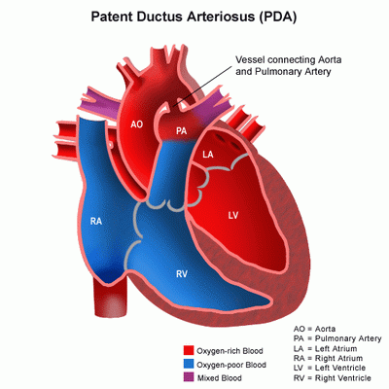
PATENT DUCTUS ARTERIOSUS (PDA)
The ductus arteriosus (DA) connects the pulmonary artery to the descending aorta during fetal life.
PDA results when the ductus fails to close after birth.

Slide 44
Patency of the ductus
Factors that maintain patency:
-prostaglandins produced by the placenta and the ductus itself
-nitric oxide like vasodilators produced by the ductus
-low oxygen tension
Factors that promote closure:
-high oxygen tension
-indomethacin

Slide 45
Closure of the ductus
During the first 60 hours of life, spontaneous closure of the ductus occurs in 55% of full-term newborn infants.
By 2-6 months of age, closure occurs in more than 95% of healthy infants
Persitence patency
Persistent patency of the ductus arteriosus following birth is inversely related to gestational age.
Reopening of the ductus:
-may occur in asphyxia
-pulmonary diseases (as hypoxia and acidosis relax ductal tissues).

Slide 46
PDA
Pathophysiology:
  Blood flows from aorta to the pulmonary
  artery, creating a left to right shunt, resulting
  in left atrium and ventricle overload.
  Increased pulmonary blood flow can result in
  pulmonary hypertension and reversal of the
  shunt, which is known as Eisenmenger’s
  reaction. This results in flow of
  desaturated blood to the lower extremities.

Slide 47
PDA
Symptoms:
  Children with small patent ductus arteriosus are usually asymptomatic.
  Large left to right shunts develop symptoms of congestive heart failure such as;
    Tachypnea,
    Tachycardia,
    Poor feeding or tiring when feeding
    slow growth (poor weight gain)
    sweating
Physical exam:
  Continuous murmur heard best at the upper left sternal border (machinery murmur)

Slide 48
physical examination findings
Inspection:
•Carotid pulsations
•Hyperkinetic apical impulse
Palpation:
systolic or continous thrill at the 2nd left interostal space
Auscultation:
continous/machinery murmur at the 2nd LICS

Slide 49
PDA
INVX:
CXR: Cardiomegally, LA enlargement, LV enlargment, Prominent aortic Knuckle, Pulmonary plethora
ECG: left atrial enlargement, Left ventricular hypertrophy
ECHOCARDIOGRAPHY: doppler flow through the ductus

Slide 50
Management
MEDICAL
- Indomethacin (prostaglandin E1 inhibitor) may close a PDA if given in the first 10 days at 0.1 mg/kg/dose, orally, bd for three doses
-Digoxin for increasing working capacity of heart
-Diuretics (furosemide)to reduce preload on heart
-fluid restriction

Slide 51
SURGICAL
After one week following indomethacin use, surgical closure by ligation, clipping, or division can be done.
Out of the neonatal period, cardiac catheterization with coil occlusion has become the primary mode of closure.
Newer occlusion devices similar to ones used for ASD closure are being developed for closure of the large PDA in older children and adults

